Slide 1
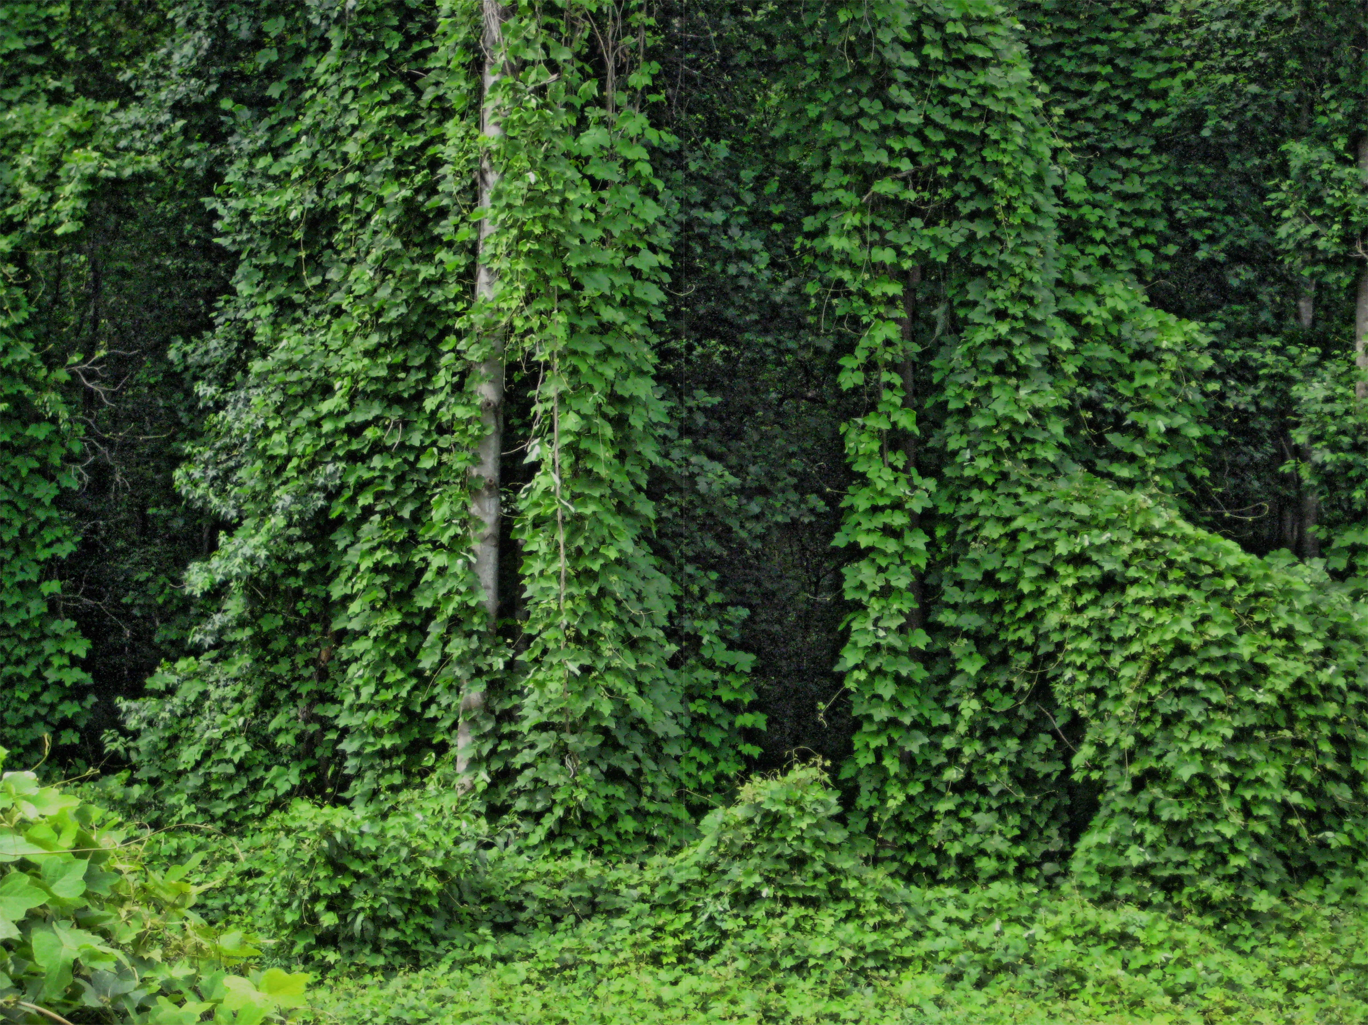
The Problem
Invasive plants are non-native species that lack natural controls and can smother native habitats. Several familiar landscape plants are invasive.
Kudzu invasion

Slide 2
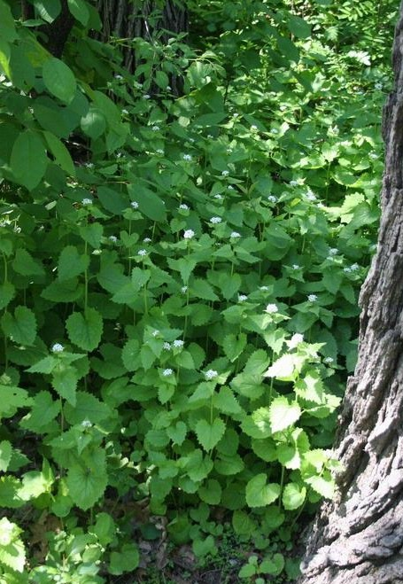
Consequences of Invasive Plants
1
Invasive plants spread aggressively and re-seed widely, taking over ecosystems.
2
They displace beneficial native plants, outcompeting them for nutrients, light, and space.
3
They upset the balance of nature, destroying habitat and food sources needed by wildlife.
Garlic Mustard
Seeds of many invasive plants are dispersed by birds and wind. Homeowners are often unaware that invasive plants on their property can spread to other areas.

Slide 3
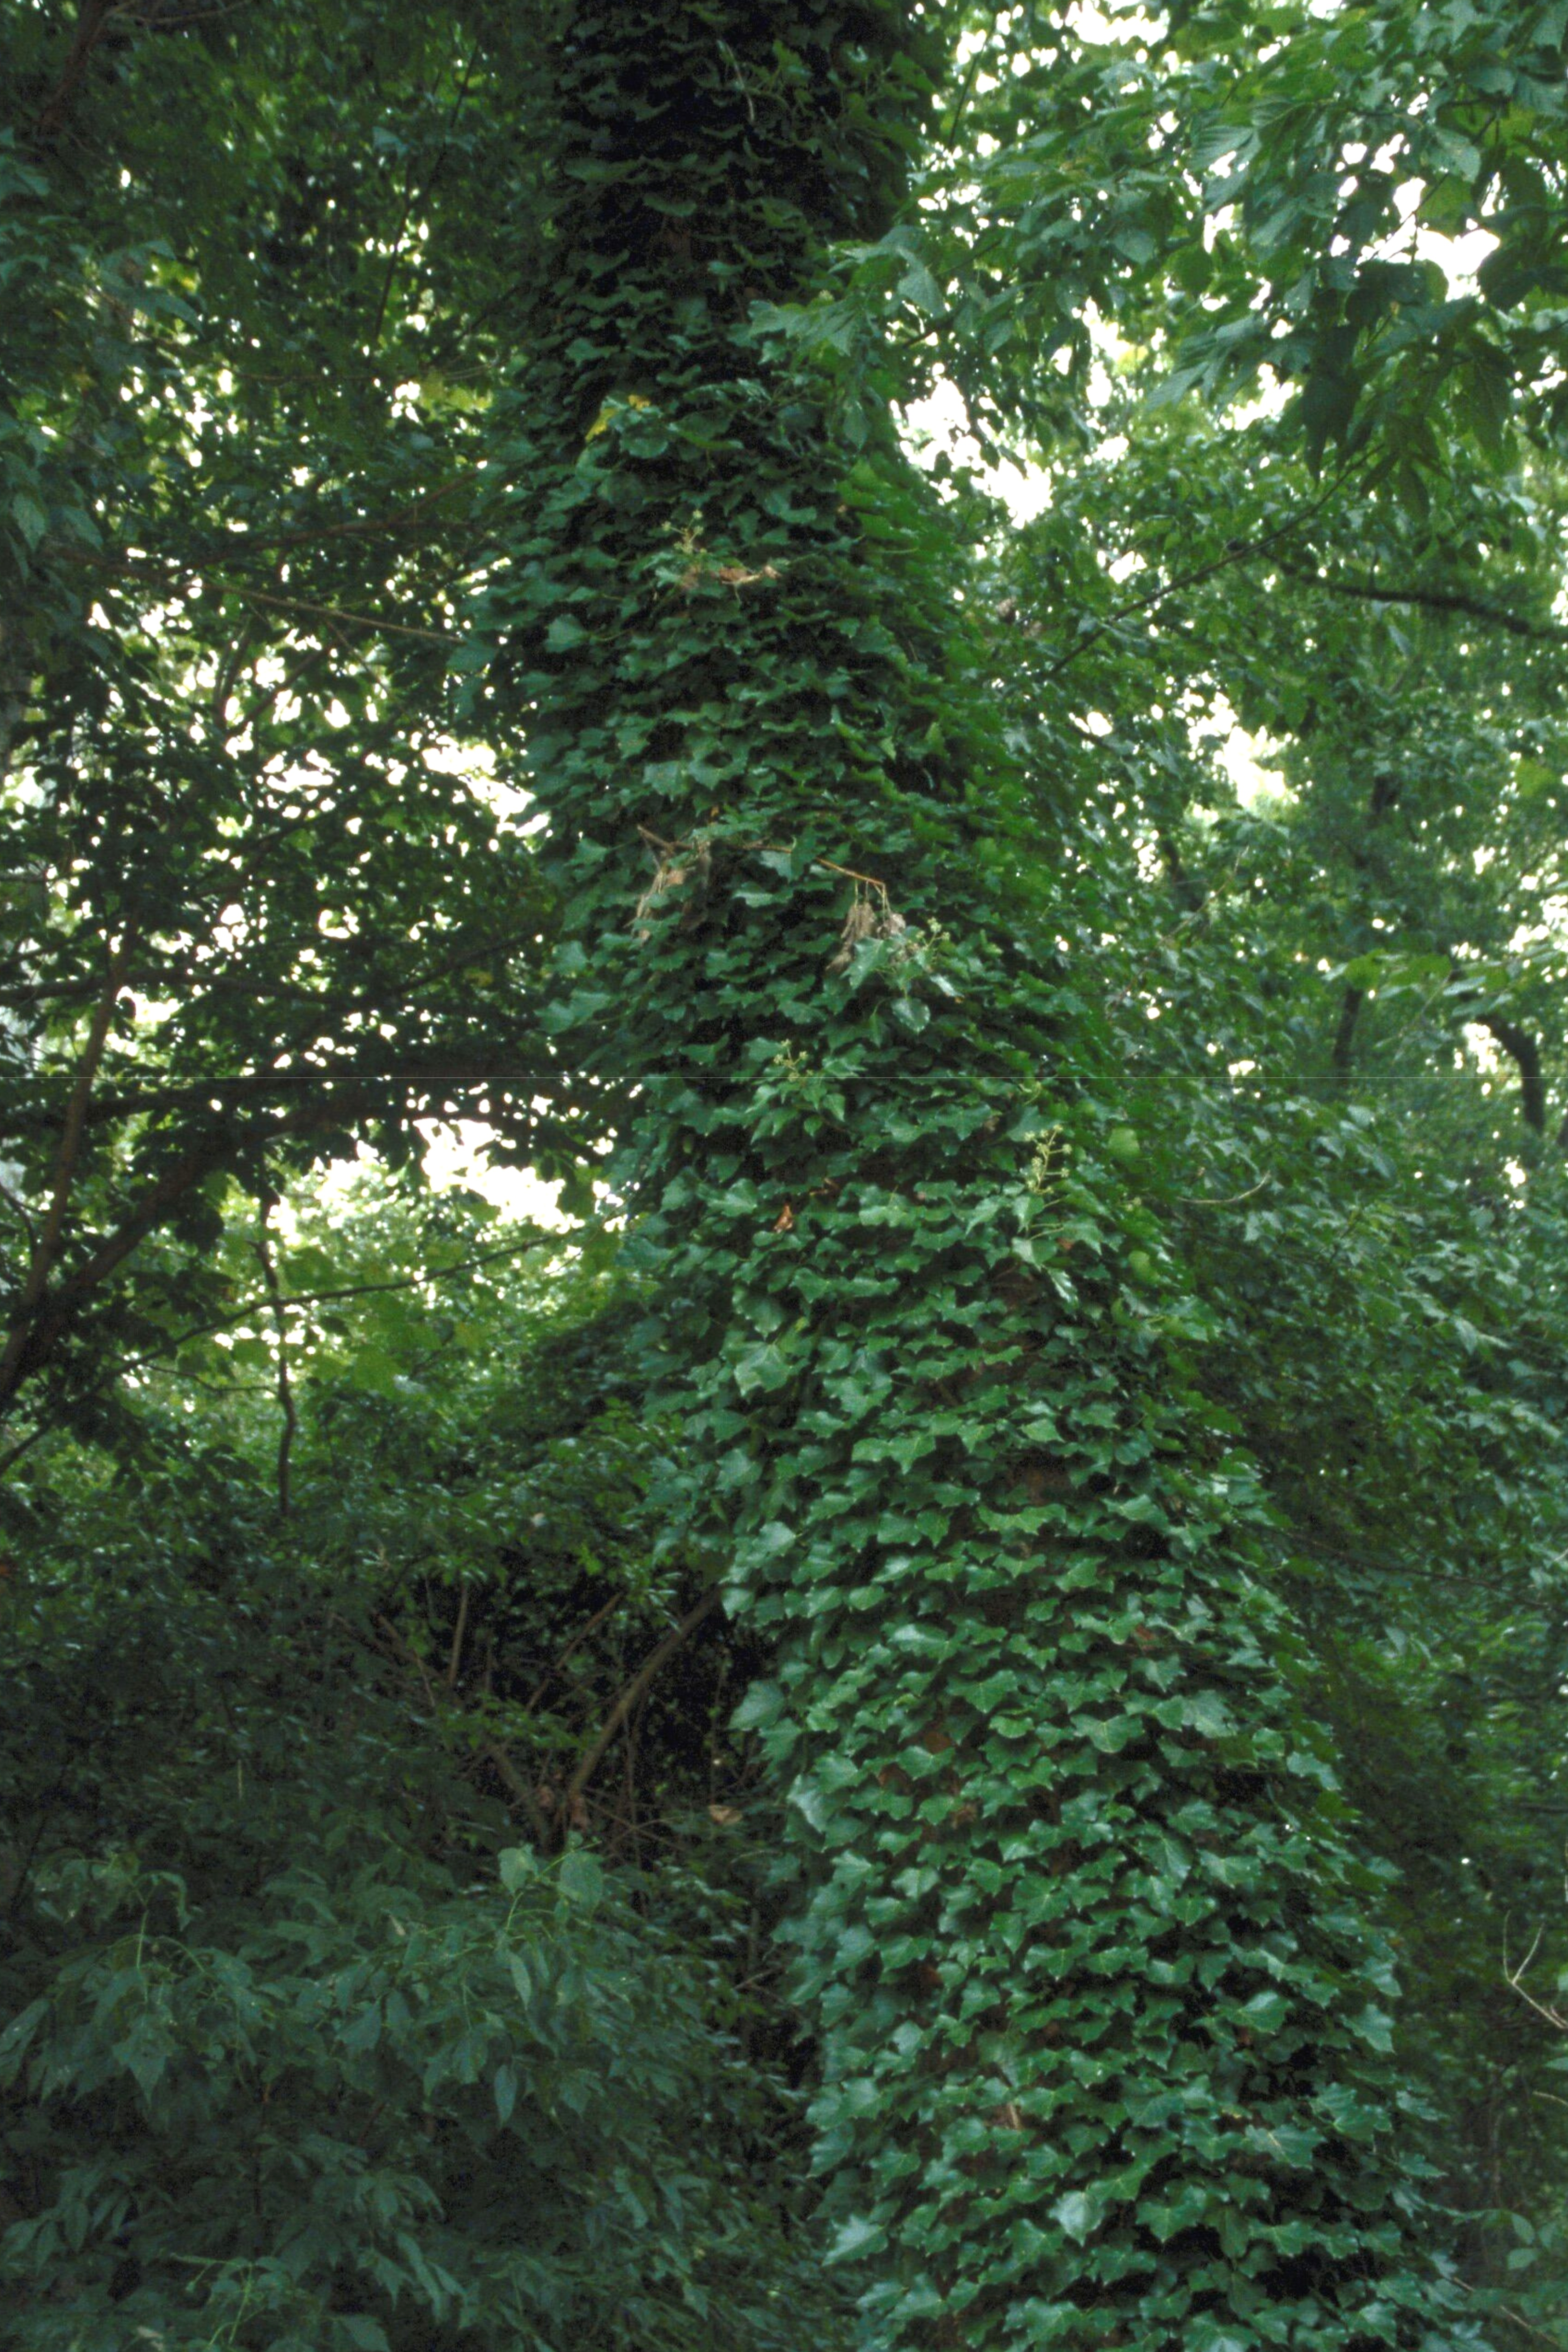
1
What Can You Do about It?
ID the worst offenders
English ivy
Smothers and blocks sunlight from reaching other plants. Topples mature trees.
Japanese barberry
Invades fields, woodlands, and wetlands. May contribute to deer tick populations.
Japanese honeysuckle
On ground, forms dense mats; in trees, shades growth below. Strangles saplings.
Winged burning bush
Spreads widely by seed, taking over woods and fields.
English Ivy

Slide 4
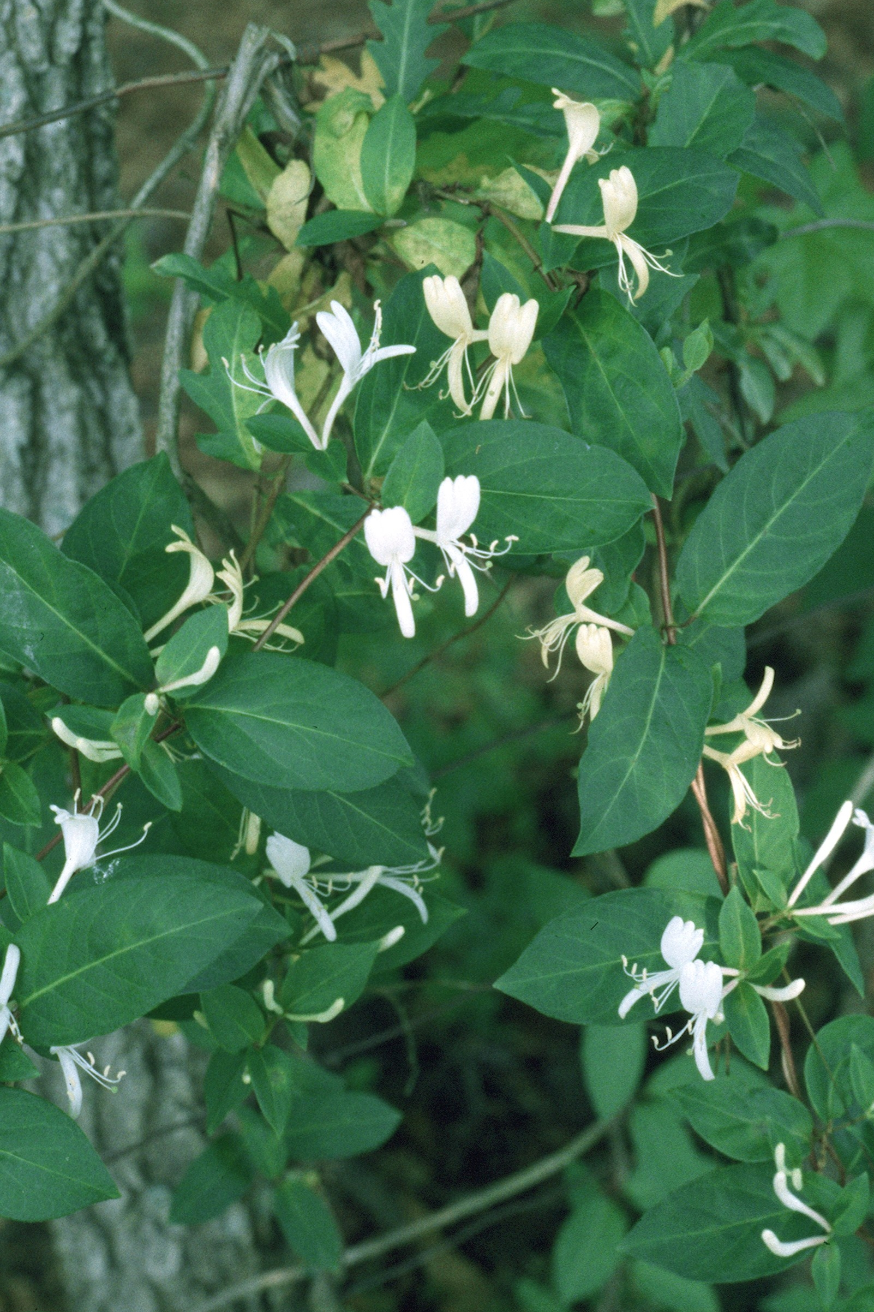
2
What Can You Do about It?
Pull it! Don’t plant it!
Eradicate invasive plants in your yard:
Pull small invasive plants, seedlings, and saplings.
Cut invasive shrubs to the ground, either grinding out stumps or applying approved systemic herbicide to kill roots.
Cut vines and treat ends with herbicides or smother with cardboard for a season.
Carefully dispose of cuttings, roots, and seeds so plants can’t grow back.
Japanese
Honeysuckle

Slide 5
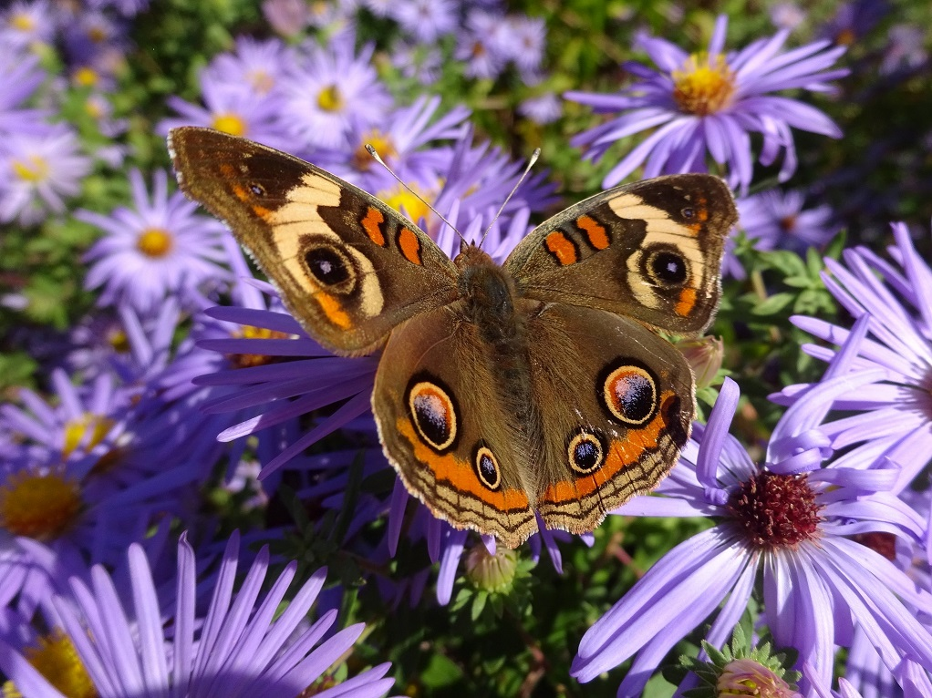
3
What Can You Do about It?
Choose native plants
Plant wildlife-friendly native perennials, vines, shrubs, and trees that grow in harmony with other plants and support birds, pollinators, and other beneficial insects.
Shop at nurseries specializing in native plants, and ask garden centers and landscapers for native plants.

Slide 6
Credits
Photos used under Creative Commons licenses:
https://creativecommons.org/licenses/by-nc-nd/2.0/legalcode
"Kudzu, The Vine That Ate the South” by Frank DiBona via flickr.com (reduced brightness)
https://creativecommons.org/licenses/by/2.0/legalcode
“Garlic Mustard” by Steven Latovich, U.S. Forest Service via http://commons.wikimedia.org (cropped)
https://creativecommons.org/licenses/by/3.0/legalcode
“English Ivy” by Jil Swearingen, USDI National Park Service, Bugwood.org (cropped, increased brightness)
“Japanese Honeysuckle” by Jerry A. Payne, USDA Agricultural Research Service, Bugwood.org (cropped)
“Common Buckeye Butterfly” courtesy Martha K. Johnston

